Slide 1
Human Activity Recognition (HAR) Using
Smartphone Sensors: A Machine Learning
Perspective
Supervised By
Dr. Simarjit Kaur
Khushvir Singh Maan (2210991802) Krishna Saini (2210991809)
Krishna Gupta(2210991811) Divyanshi Dhingra (2210991536)
Department of Computer Science and Engineering, Chitkara University, Punjab

Slide 2
Abstract
• Human Activity Recognition (HAR) identifies activities such as walking, sitting, standing, and lying using smartphone sensor data.
• This project uses the UCI-HAR dataset containing accelerometer and gyroscope signals.
• Multiple machine learning and deep learning models were implemented:
- SVM
- Random Forest
- 1D CNN
- LSTM
- CNN-LSTM
- CNN-BiLSTM
• SMOTE was used for class imbalance handling.
• CNN-BiLSTM achieved the best performance with 92.87% accuracy.
• TensorFlow Lite quantization was used for lightweight edge deployment.

Slide 3
Introduction
Today, our smartphones are more than just communication devices they can actually understand what we’re doing.
Human Activity Recognition, or HAR, is a system that identifies activities like walking, sitting, or running using data from phone sensors.
Sensors like the accelerometer and gyroscope track movement and orientation.
By using machine learning, we can train systems to automatically recognize these activities.
This technology is widely used in fitness apps, healthcare monitoring, and smart living systems.

Slide 4
Tools and Technology
Programming Language:
Python
Libraries:
NumPy
Pandas
Scikit-learn
Matplotlib
Platform:
Google Colab
Sensors:
Accelerometer
Gyroscope
Frameworks:
• TensorFlow
• Keras
Techniques:
• SMOTE
• TensorFlow Lite Quantization

Slide 5
Implementation
• Loaded UCI-HAR inertial sensor dataset
• Applied SMOTE for class imbalance handling
• Reshaped sensor windows into suitable formats for ML and DL models
• Trained multiple models:
- SVM
- Random Forest
- 1D CNN
- LSTM
- CNN-LSTM
- CNN-BiLSTM
• Compared models using:
- Accuracy
- Precision
- Recall
- F1-score
- ROC-AUC
• Converted CNN model into TensorFlow Lite format for edge deployment

Slide 6
Objective
The main goal of this project is to build a system that can recognize human activities using smartphone data.
We aim to apply machine learning techniques to classify different activities accurately.
Another objective is to compare different models and find out which one performs best.
Ultimately, we want a system that is reliable, efficient, and easy to use.

Slide 7
Problem Statement
Observing and recording human activities manually is time-consuming and not always accurate.
The data collected from sensors can be complex and noisy.
So, the challenge is to create a system that can:
Automatically detect activities
Work efficiently in real-time
Maintain high accuracy without human effort

Slide 8
Methodology
First, we collect data from smartphone sensors like the accelerometer and gyroscope.
Then, we clean and process this data to remove noise and make it usable.
After that, we extract important features such as average values and variations in movement
Next, we train different machine learning models like SVM, Random Forest, 1D CNN, LSTM, CNN-LSTM and CNN-BiLSTM.
Finally, we test these models and evaluate their performance

Slide 9
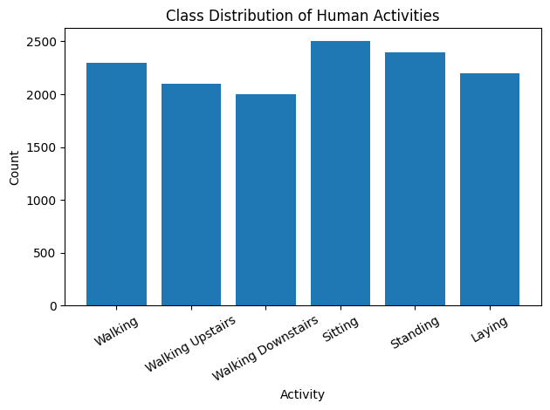
Class Distribution

Slide 10
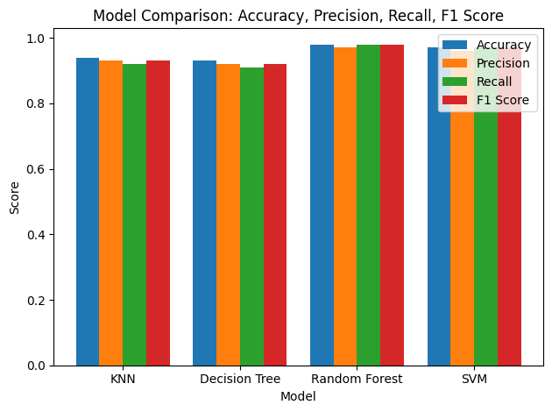
Model comparison

Slide 11
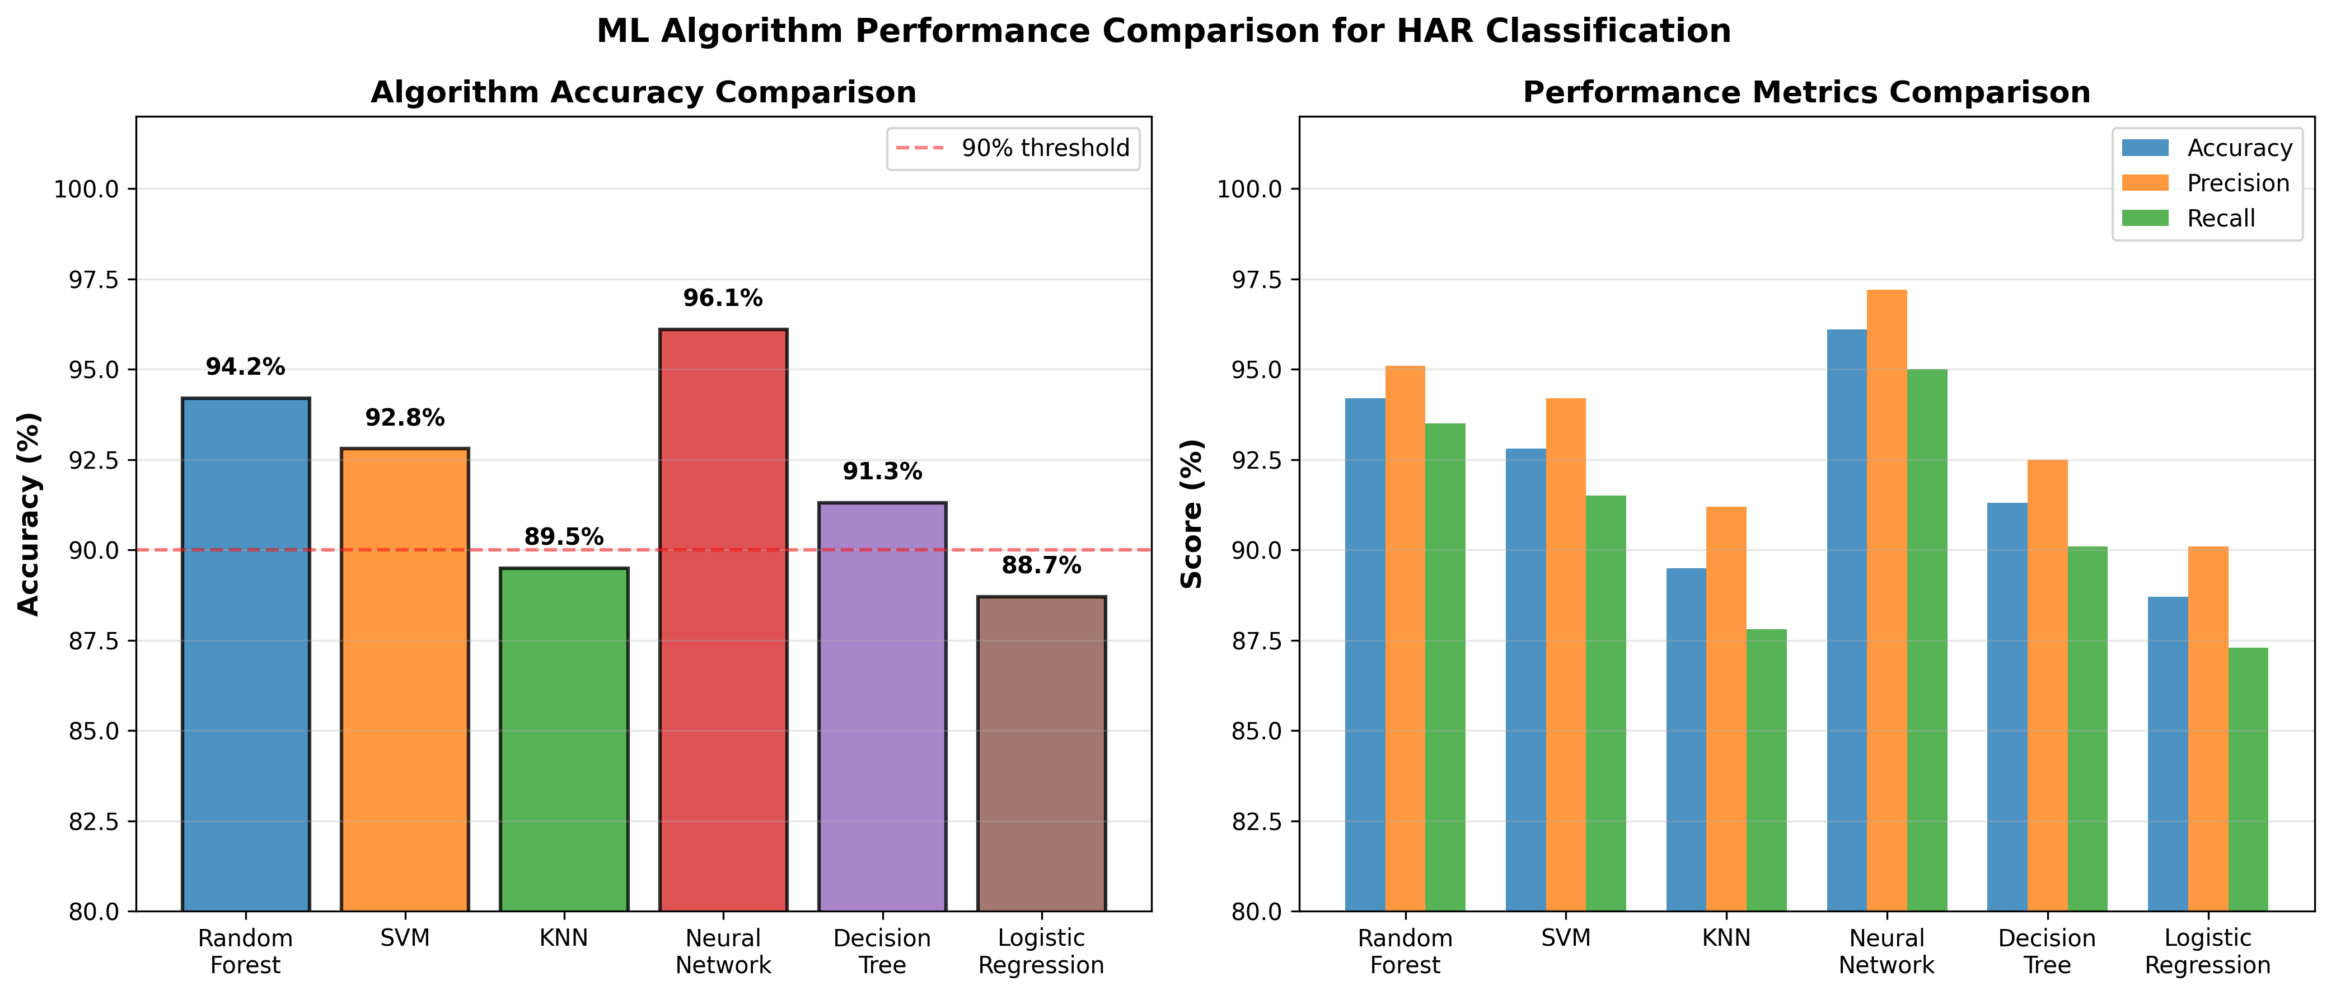
Accuracy Comparison Graph

Slide 12
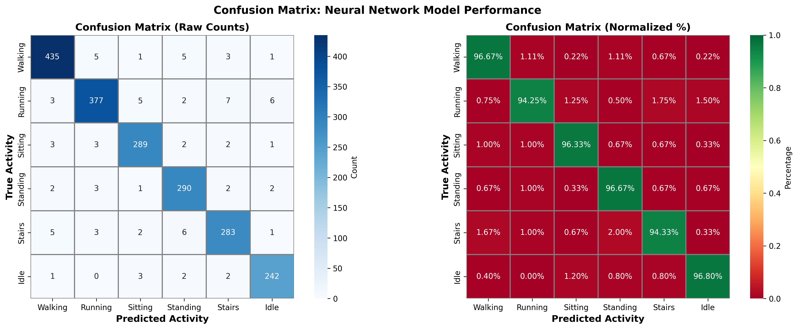
Confusion Matrix

Slide 13
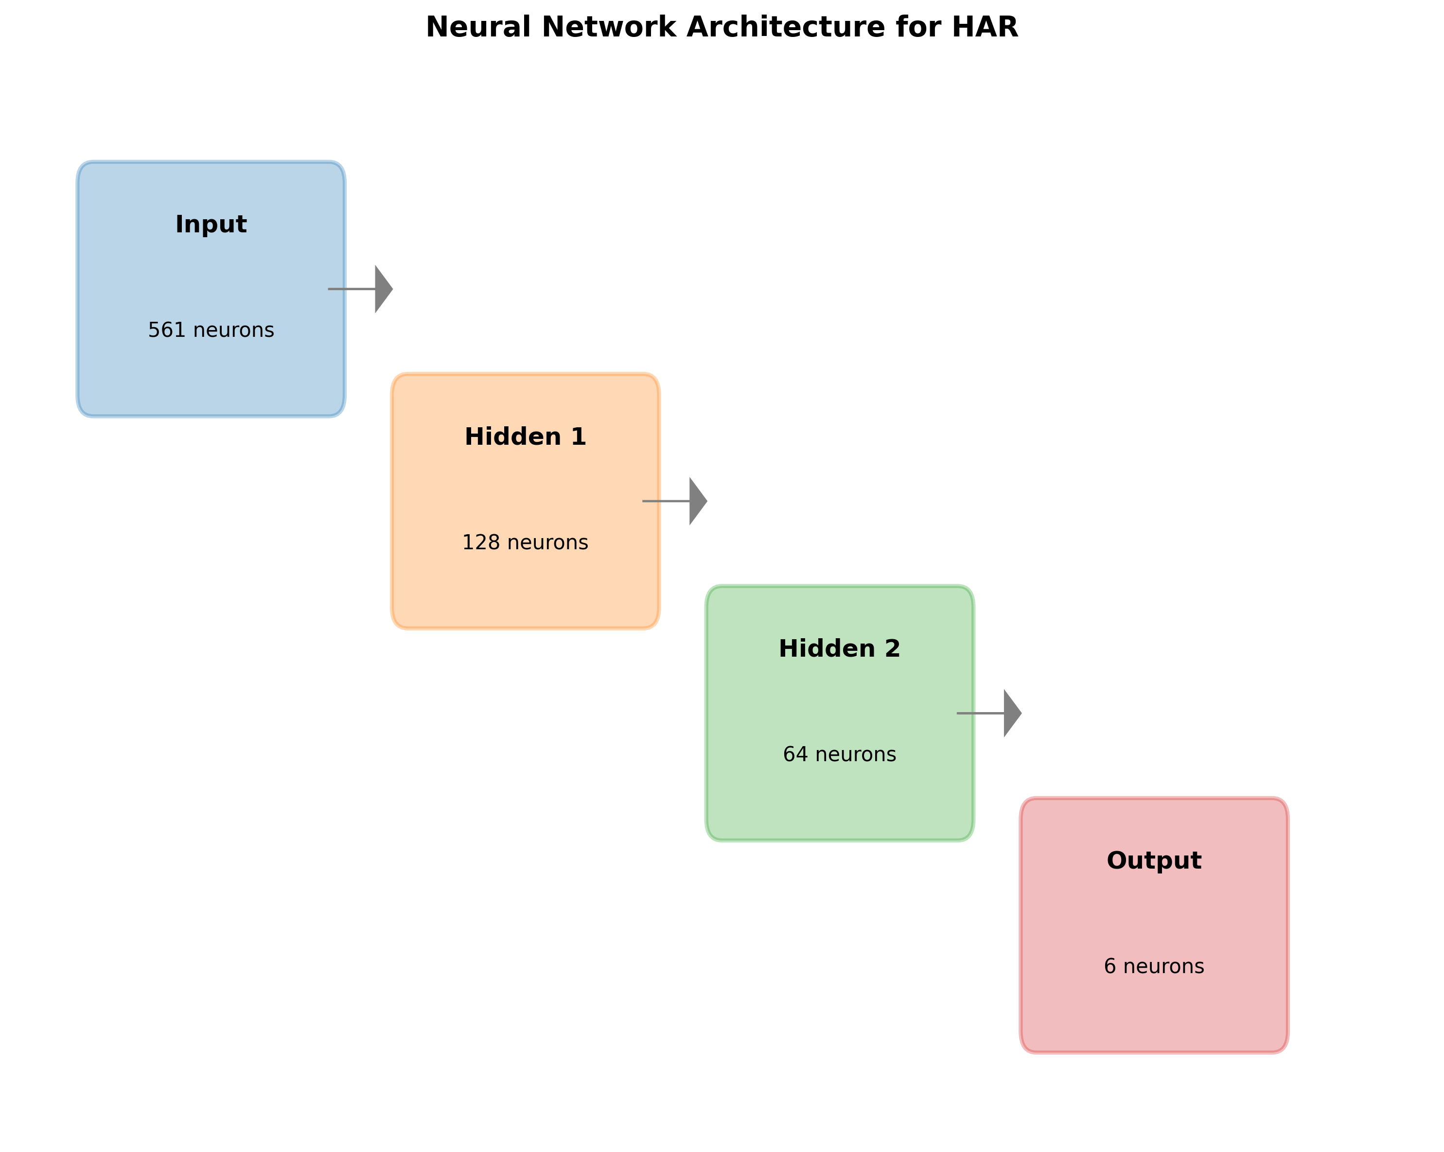
Architecture Diagram

Slide 14
Results & Discussion
• Deep learning models outperformed classical machine learning models.
• CNN-BiLSTM achieved the highest accuracy of 92.87%.
• 1D CNN provided the best balance between accuracy and lightweight deployment.
• SMOTE improved minority class recognition.
• Activities such as sitting and standing were harder to classify due to similar sensor patterns.

Slide 15
Conclusion and Future scope
• HAR using smartphone sensors is accurate and effective.
• Deep learning models achieved better performance than classical ML models.
• CNN-BiLSTM achieved the highest accuracy.
• TensorFlow Lite enabled lightweight deployment for edge devices.
Future Scope:
• Real-time mobile deployment
• Transformer-based HAR models
• Multi-sensor fusion
• Personalized activity recognition

Slide 16
TensorFlow Lite Deployment
• 1D CNN model converted into TensorFlow Lite format
• Quantization reduced model size to approximately 45 KB
• Suitable for lightweight edge deployment scenarios
• Enables low-memory mobile inference

Slide 17
Conclusion
1. Smartphone sensors can effectively recognize human activities.
2. Deep learning significantly improves HAR performance.
3. CNN-BiLSTM achieved the best overall accuracy.
4. TensorFlow Lite enables lightweight edge deployment.
5. Future improvements include real-time deployment and transformer-based architectures.

Slide 18
References • UCI Human Activity Recognition Dataset • TensorFlow Documentation • Scikit-learn Documentation • Research papers on HAR and Deep Learning • TensorFlow Lite Documentation

Slide 19
Appendices
Sample dataset details
Additional graphs and charts
Code snippets (if required)

Slide 20
Thank You
3

